Slide 1

PROBABILITY & DISTRIBUTIONS
Yin Yao
yin_yao@fudan.edu.cn
Statistical Genomics and Data Analysis Core

Slide 2
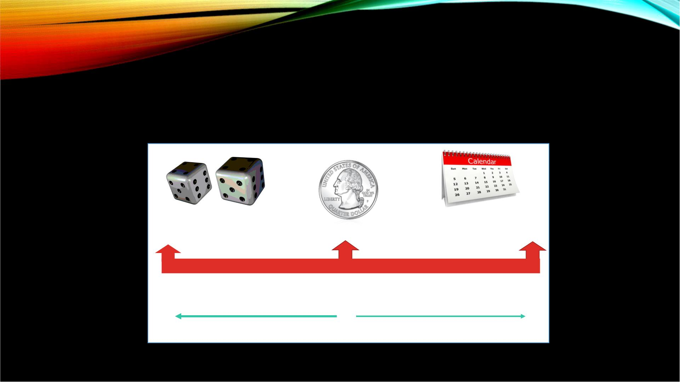
PROBABILITY
• A measure of the likelihood of an outcome
a 14
(12 < 14)
If today is Wednesday,
tomorrow is Thursday
Impossible
More unlikely
Even chance
Certain
More likely

Slide 3
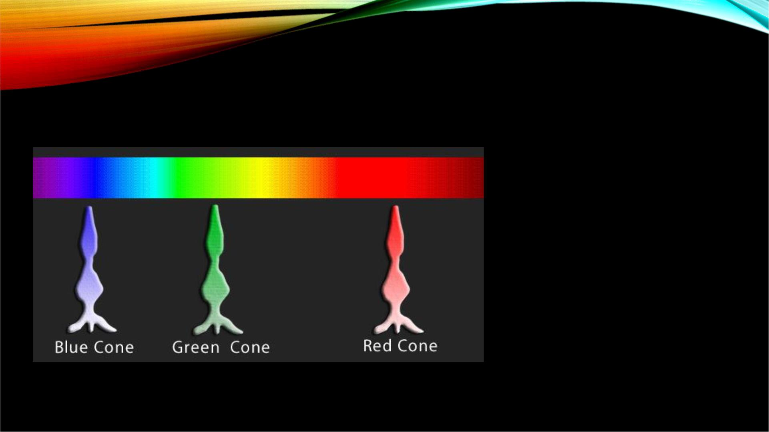
HUMAN CONE CELLS: EXAMPLE
In a certain sample
of ocular tissue
there are
approximately
5,000 cone cells.
Suppose a cell is
examined at
random.

Slide 4

HUMAN CONE CELLS: EXAMPLE
• Experiment
• he act of picking a random cell and observing its color
absorbance
• Simple Event
• the act of picking a red absorbing cone cell, for example
• Event
• the act of picking a cell absorbing cool toned colors (blue cone
cells and green cone cells), for example
• Sample Space
• A red, blue, or green absorbing cone cell

Slide 5
PROPERTIES OF PROBABILITY
1. The probability of any event E, P(E), must be
between 0 and 1 inclusive.
0 < P(E) < 1.
2. If the sample space S = {e , e , …, e }, then
1 2
n
P(e ) + P(e ) + … + P(e ) = 1.
1
2
n

Slide 6

COIN TOSS
(EQUAL OUTCOMES EXAMPLE)
Suppose a coin is tossed
• Possible outcomes = Heads or
Tails
Assuming the coin is fair
• P(heads) = P(tails)
• P(heads) + P(tails) =1
∴ P(heads) = P(tails) = 0.5

Slide 7
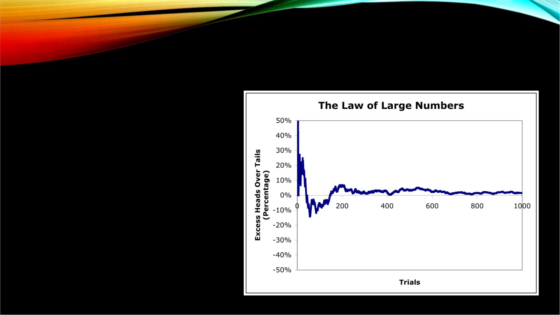
LAW OF LARGE NUMBERS
As number of repetitions
increases,
the proportion of a certain
outcome approaches the
probability
(coin toss example) → as # of
tosses increases,
proportion of heads
approaches 0.5

Slide 8
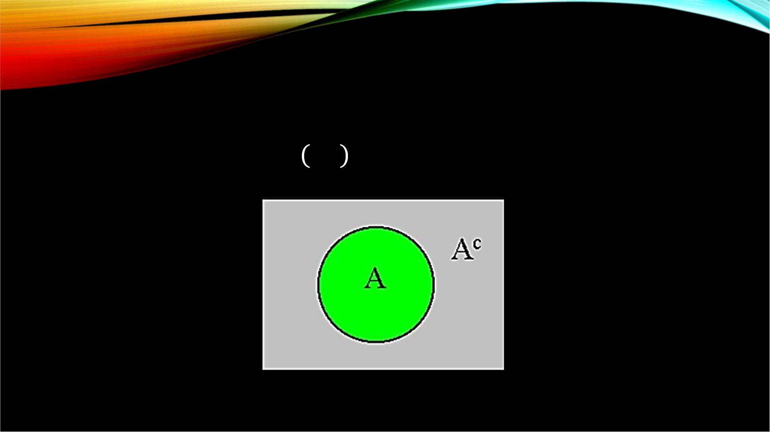

RULE OF COMPLEMENTS
퐶
$$−P(A)$$
푃 퐴 = 1

Slide 9

HUMAN MALE COLORBLINDNESS
Rule of Complements
Male Colorblindness
5%
7.5%
푃(푚푎푙푒 푛표푡 푏푒) = ?
Colorblind males
= 1 − 푝(
푚푎푙푒)
?
= 1 −0.075 =0.92

Slide 10

UNION
A U B
•What is the union
between events
A and B？
A
B

Slide 11
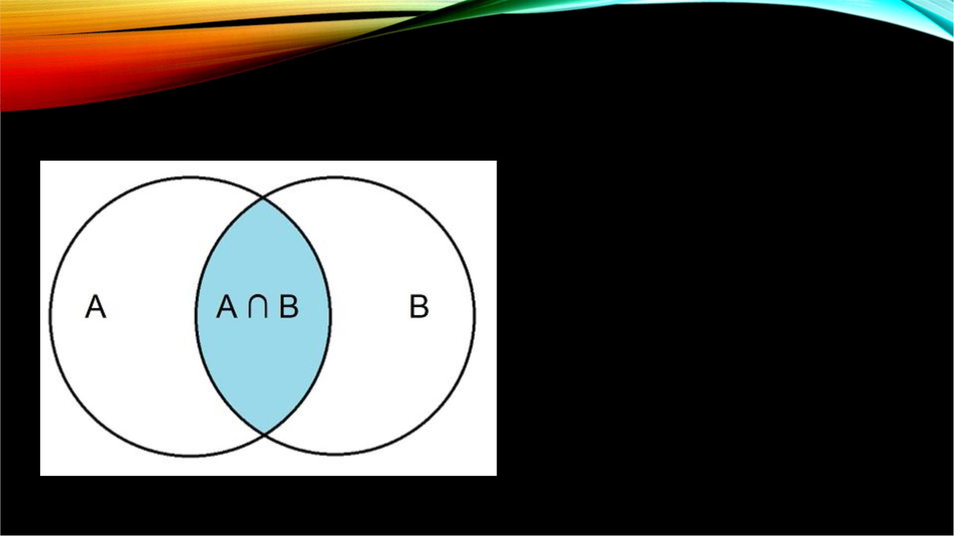
INTERSECTION
•What is the
intersection
between events
A and B？

Slide 12
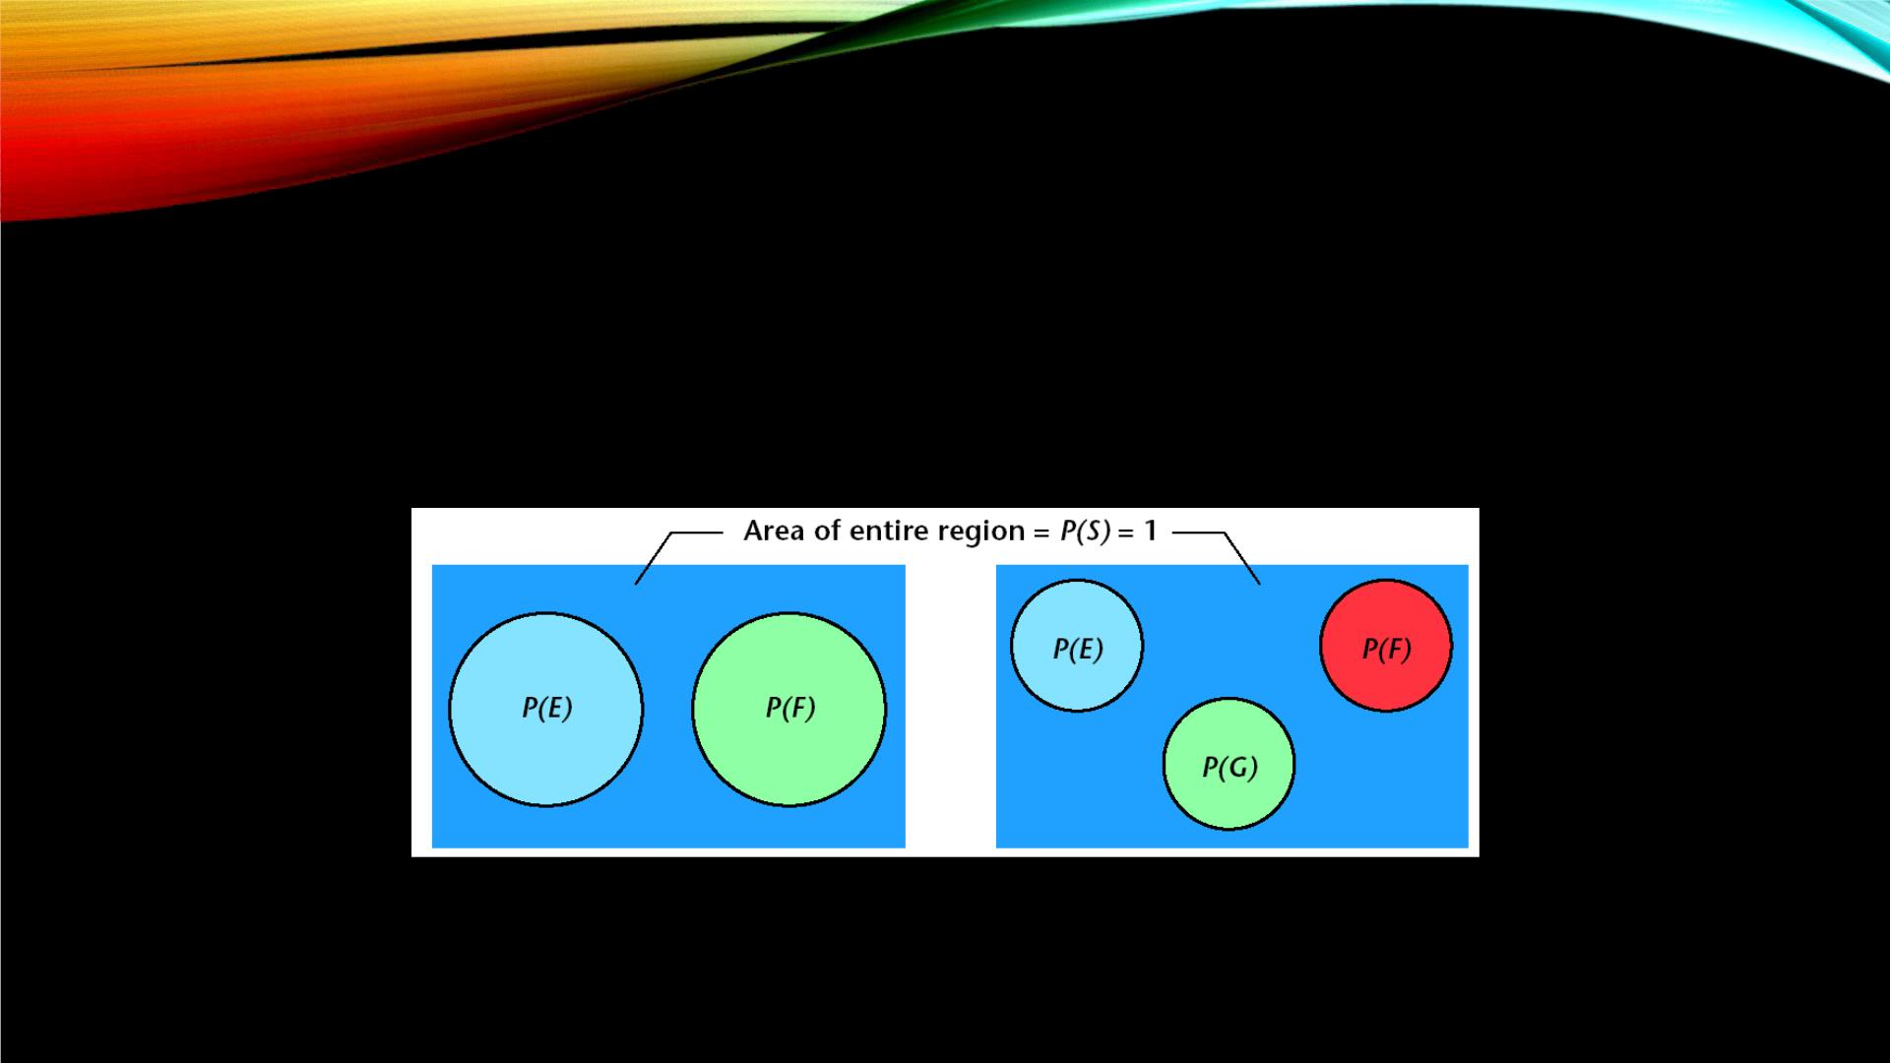
MUTUAL EXCLUSIVITY
• Two events have no outcomes in common or cannot occur
simultaneously (P(A ∩ B) = 0 and P(A U B) = P(A)+P(B))
Events E and F are
Events E, F and G are
Mutually Exclusive
Mutually Exclusive

Slide 13
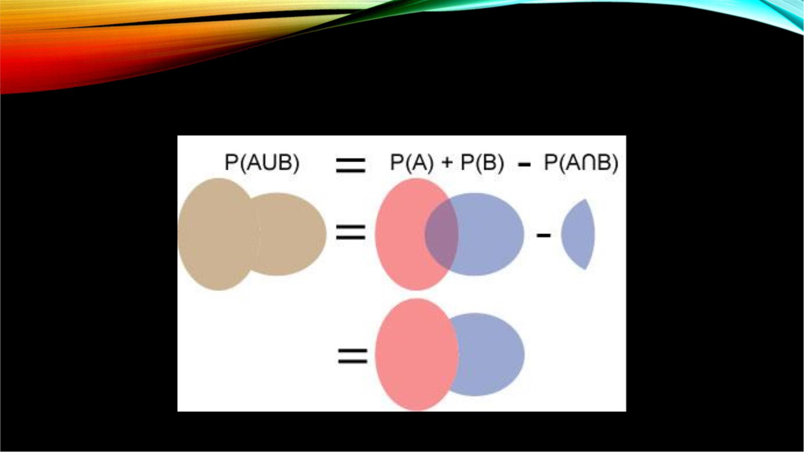
THE ADDITIVE RULE
Notes:
多除少补

Slide 14
TWO NEURONS FROM PRIMARY
VISUAL CORTEX: EXAMPLE
• Analyzed two neurons during 100 milliseconds of the stimulus
• Event A: the first neuron fires at least once within 100 millisecond time interval
• Event B: the second neuron fires at least once within 100 ms time interval
• A U B: at least one of the 2 neurons fires at least once
• A ∩ B: both neurons fire at least once
• Events A and B cannot be mutually exclusive because it is possible that both
neurons will fire during the time interval
(Kelly et. al., 2007, Comparison of recordings from microelectrod arrays and single electrodes in
the visual cortex, J. Neurosci., 27: 261–264.)

Slide 15
TWO NEURONS FROM PRIMARY
VISUAL CORTEX: EXAMPLE
• P(first neuron firing at least once)
• P(A) = 0.13
• P(second neuron firing at least once)
• P(B) = 0.22
• P(both firing at least once)
• P(A ∩ B) = 0.063
• P(at least one neuron firing)
• P(A $∪$ B) = P(A) + P(B) − P(A ∩ B) = P(first neuron) + P(second neuron) – P(both neurons)
• P(A $∪$B) = 0.13 + 0.22 – 0.063
• P(A $∪$ B) = 0.287
(Kelly et. al., 2007, Comparison of recordings from microelectrod arrays and single electrodes in
the visual cortex, J. Neurosci., 27: 261–264.)

Slide 16

TYPES OF PROBABILITY
Probability
Marginal Joint Conditional
Probability Probability Probability

Slide 17

MARGINAL PROBABILITY

Slide 18

MARGINAL PROBABILITY
• the probability of an event occurring (p(A))
• “unconditional probability”
• not conditioned on another event
• EXAMPLE:
• probability that a card drawn is red:
• (p(red) = 26 red / total 52 cards = 0.5)
• probability that a card drawn is a 4:
• (p(four)= 4 fours / total 52 cards = 1/13)

Slide 19
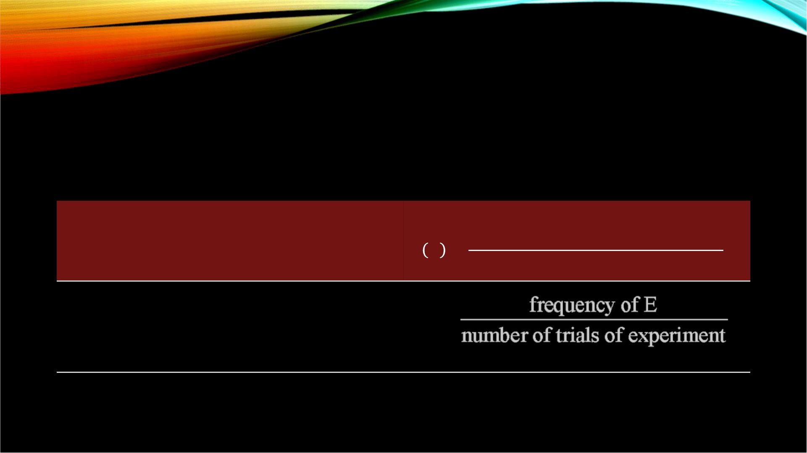
PROBABILITY OF AN EVENT
3 Methods
(equal outcomes)
Classical
푁푢푚푏푒푟 표푓 푤푎푦푠 푡hat E can occur
푃 퐸 =
푁푢푚푏푒푟 표푓 푎푙푙 푝표푠푠ible
표푢푡푐표푚푒푠
Empirical
P(E) =
Subjective
based on an educated guess
(there is a 40% chance of rain
tomorrow)

Slide 20

SCHIZOPHRENIA IN US
POPULATION
In a sample of 300 people:
Schizophrenia in US
Population
• 9 have been diagnosed with
schizophrenia
• 291 are unaffected
Schizophrenic
Unaffected
Randomly choosing an individual, what is
the probability they have been diagnosed
with schizophrenia?
P(schizophrenia) = ?

Slide 21

P(SCHIZOPHRENIA) = ?
Diagnosed with
Schizophrenia
9
P(schizophrenia) =
= = 0.03
300
Total

Slide 22
SOCK DRAWER: EXAMPLE
• We have a drawer containing 3 yellow, 2 red, and 2 green pairs of socks,
and 1 blue pair.
• P(picking a yellow pair) = ？
= 3/8 = 0.375
• Possible outcomes: (Y, Y, Y, R, R, G, G, B)
• This is also termed the sample space

Slide 23

SOCK DRAWER: EXAMPLE
• Now we are interested in the probability of selecting a non-blue pair from
the drawer.
Y, Y, Y, R, R, G, G
Y, Y, Y, R, R, G, G, B
• 푃(
• 푃(
푎 푛표푛 − 푏푙푢푒) =
푎 푛표푛 − 푏푙푢푒) = 7/8 = 0.875
• Sample space = (Y, Y, Y, R, R, G, G, B)

Slide 24

DIE: EXAMPLE
• We have a fair die with 6 sides numbered 1 to 6:
• P(1) = ？
• P(1) = 1/6 = 0.167
• P(1 or 6) = ？
• P(1 or 6) = 2/6 = 1/3 = 0.333
• P(2 and 3) = ？
• Remember we only have 1 die
• P(2 and 3) = 0

Slide 25
JOINT PROBABILITY

Slide 26

JOINT PROBABILITY
• The probability of the intersection of two or more events
• That is, the probability of event A and event B occurring
• p(A ∩ B)
• EXAMPLE:
• the probability that a card is a four and red:
푝(푓표푢푟 푎푛푑 푟푒푑) =
2 푟푒푑 푓표푢푟푠 / 푡표푡푎푙 52 푐푎푟푑푠
= 1/26
Notes:
两个红色

Slide 27

M&M’S: EXAMPLE
• 2 jars of m&m’s
• 2 blue in each
• 2 red in each
If 2 m&m’s are picked from each jar
with replacement, what is the
probability of the combination
Blue Blue Red Red？

Slide 28
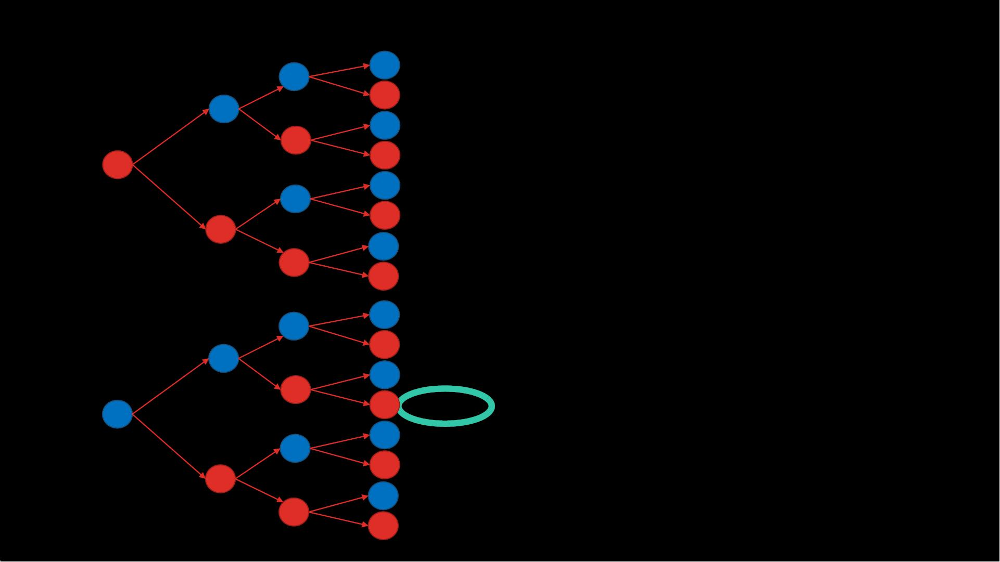
1st draw
2nd jar
2nd draw
2nd jar
AN INTUITIVE
METHOD: ALL
2nd draw
1st jar
B
R
B
R
B
R
B
R
RB BB
B
RB BR
RB RB
RB RR
RR BB
RR BR
RR RB
RR RR
1st draw
1st jar
B
POSSIBLE OUTCOMES
R
B
R
R
R
B
B
R
B
R
BB BB
BB BR
BB RB
B
R
R
B
BB RR 1/16 = 0.0625
B
B BR BB
^{R} BR BR
B
BR RB
R
R
BR RR

Slide 29
EXAMPLE
• Consider the mouse maze problem:
• A mouse goes through a maze, stopping at different feeding stations.
• Starting at feeding station A, the maze ends when the mouse reaches any
of the E(nd) stations.

Slide 30

P(A, B, D, E2) = ？
Probabilities
• From A, P(B)=P(C)=0.5
E1
• From B, P(E1)=0.34
P(D)=0.66
B
E2
• From C, P(E4)=0.34
P(D)=0.66
A
D
E3
• From D, P(E3)=P(E2)=0.5
C
• P(A, B, D, E2) =
E4
=0.5*0.66*0.5= 0.167

Slide 31
CONDITIONAL PROBABILITY

Slide 32


CONDITIONAL PROBABILITY
• Now we want to represent the probability that event A will happen, given
that event B happens
푃 퐴 $∩B$
That is,
푃 퐴 퐵 =
푃(퐵)
• Given that B happens, what is the probability of A？

Slide 33

COLOR VISION IN MICE
CONDITIONAL PROBABILITY
Probability of a genetically altered mouse
distinguishing between yellow and red light
correctly = 80% (0% for normal)
That is,
Given that the mouse is genetically altered,
P(correct color distinction) = 80%

Slide 34
NEUROLOGICAL DISEASE:
EXAMPLE
• Prevalence of a particular disease is 1/1000 in the general population
• false positive rate is 5%
• 98% of the people with the disease will test positive
• Assuming that you know nothing about particular individuals or their
symptoms, what is the probability that a person that has tested positive
actually has the disease？
Roberta LaHaye
University of Regina
and
Penny Nom

Slide 35
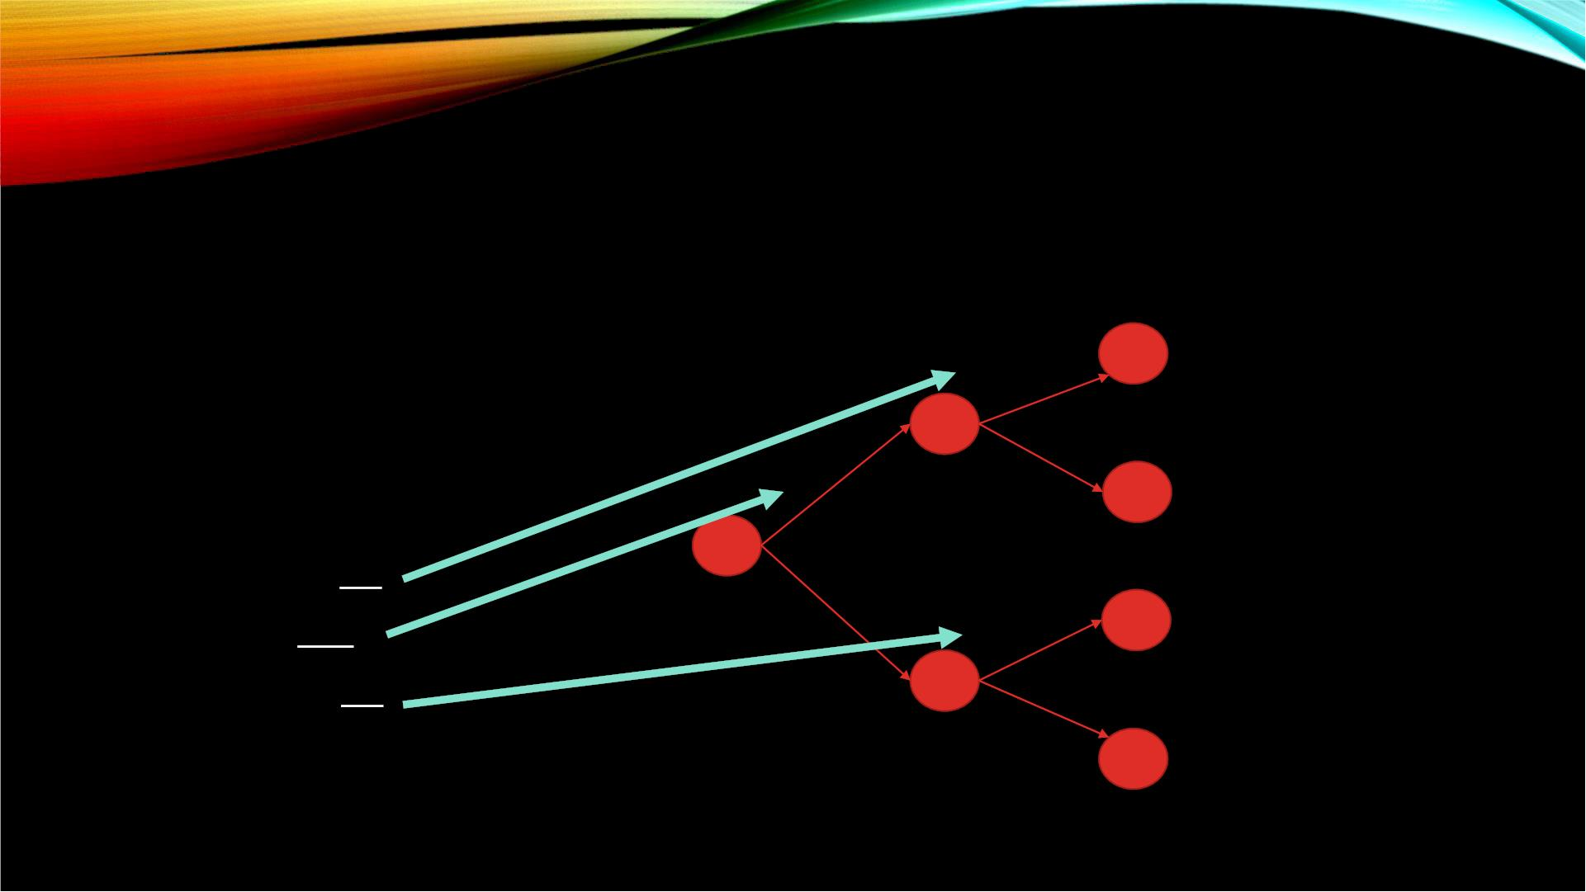
NEUROLOGICAL DISEASE:
EXAMPLE
• D = presence of the disease
• Đ = disease not present
• + = positive tests
+ True positive
98/100
D
• - = negative tests
1/1000
2/100
-
False negative
False positive
True negative
• Given that:
98
• P(+|D) =
100
1
• P(D) =
1000
5
• P(+|Đ) =
100
999/1000
+
5/100
Đ
95/100
-
• P(D|+) = ?

Slide 36
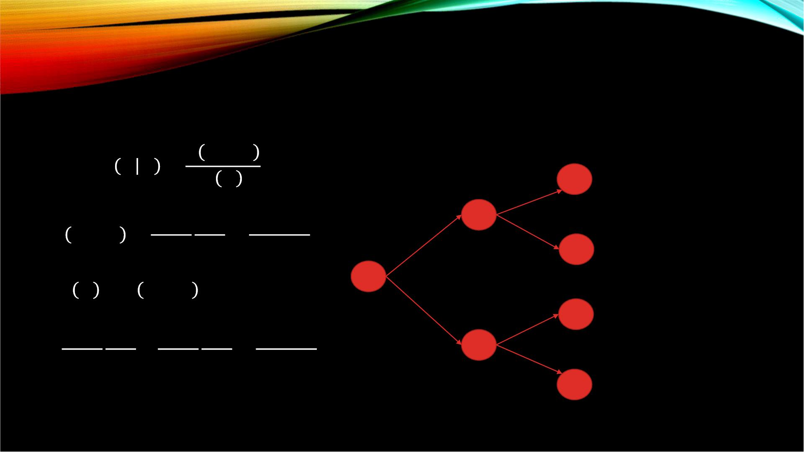



P(D|+)=？
푃 퐷 $∩+$
푃 +
푃 퐷 + =
98/100
2/100
+ True positive
1 98
98
D
푃 퐷 $∩+$ =
=
1/1000
1000 100 100000
-
False negative
False positive
True negative
푃 + = 푃 퐷 $∩+$ + 푃(Đ $∩$+)
1 98 999 5 5093
5/100
+
999/1000
=
+
=
Đ
1000 100 1000 100 100000
95/100
-

Slide 37



NEUROLOGICAL DISEASE:
EXAMPLE
• 푃 퐷 $∩$+ =
98
100000
+ True positive
98/100
• 푃 + =
5093
100000
D
1/1000
98
100000
5093
2/100
-
False negative
False positive
True negative
푃 퐷 $∩$+
푃 +
푃 퐷 + =
=
100000
5/100
+
999/1000
= 0.01924
Đ
95/100
-

Slide 38
INDEPENDENCE OF EVENTS
• To determine if 2 events are independent:
For events A and B:
P(A ǀ B) = P(A) OR P(B ǀ A) = P(B)

Slide 39
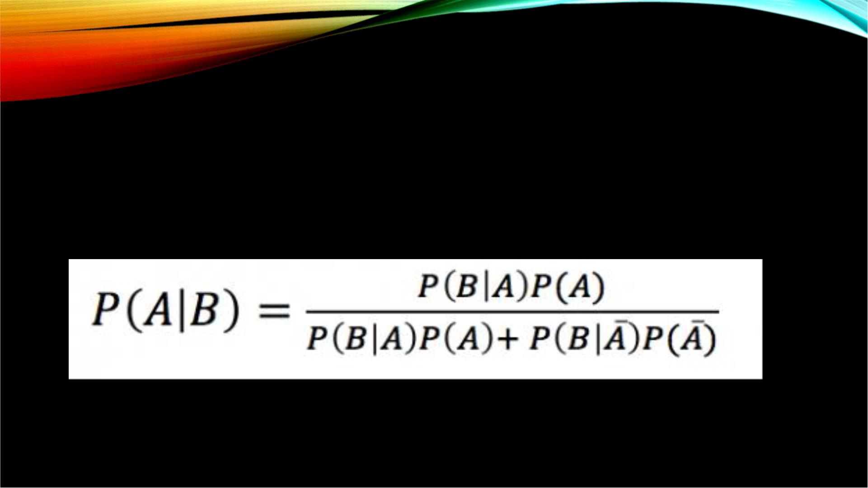
BAYES’ THEOREM
• an equation that allows us to manipulate conditional probabilities

Slide 40
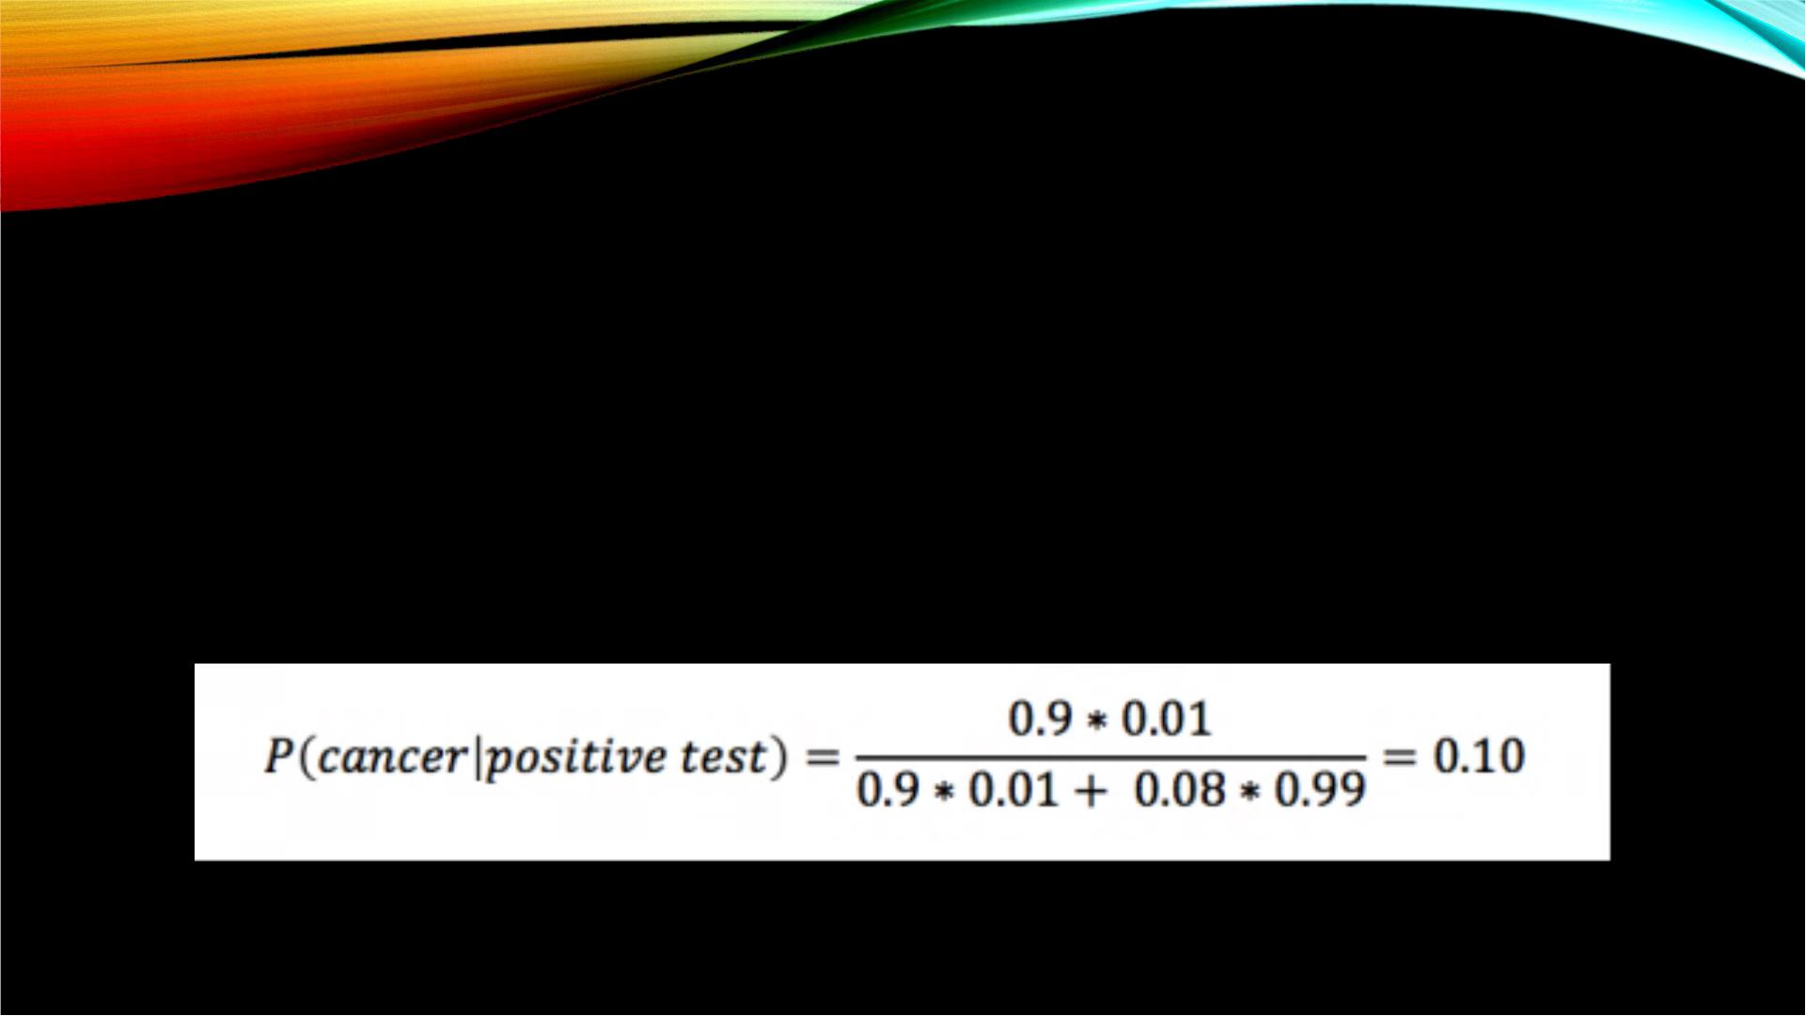
CANCER EXAMPLE
• P(A) = P(cancer) = 0.01
• P(B|A) = P(positive test|cancer) = 0.9
• P(B|Ā) = P(positive test|no cancer) = 0.08
• P(A|B) = P(cancer|positive test) = ？

Slide 41
PROBABILITY DISTRIBUTIONS

Slide 42
PROBABILITY DISTRIBUTIONS
• Variable
• A characteristic that can be measured or categorized
• Random Variable
• Determined by chance
• Every random variable has a corresponding probability distribution
• Probability distribution describes the behavior of the random variable

Slide 43

BINOMIAL DISTRIBUTION
• describes the distribution of outcomes from a series of trials where each trial
meets certain conditions
• That is, it describes the probability of X successes in n trials, given that:
• Each trial has a binary outcome (One of the two outcomes is labeled a
‘success’)
• The probability of success is known and constant over all trials
• The number of trials is specified
• The trials are independent. That is, the outcome from one trial doesn’t affect the
outcome of successive trials
$P(X)$=$\frac{n!}{X!\left(n−X\right)!}p^{X}{(1−p)}^{n−X}$
n= number of trials, p = probability of success, X = number of successes

Slide 44
BINOMIAL EXAMPLE
• What is the probability of ‘X’ heads in 6 coin tosses?
• n = 6 trials
• p = 0.5
• X = number of heads in 6 tosses which can range from 0 to 6
X ~ Bin (6, 0.5)

Slide 45




BINOMIAL EXAMPLE CONT.
• 푃 푋 = 0 =
• 푃 푋 = 1 =
• 푃 푋 = 2 =
• 푃 푋 = 3 =
6!
0! 6−0 !
6!
0.5⁰(1 $−$0.5)⁶⁻⁰
0.5¹(1 $−$0.5)⁶⁻¹
0.5²(1 $−$0.5)⁶⁻²
1! 6−1 !
6!
2! 6−2 !
6!
0.5³(1 $−$0.5)⁶⁻³
3! 6−3 !
• 푃 푋 = 4 = 푃 푋 = 2 =
• 푃 푋 = 5 = 푃 푋 = 1 =
• 푃 푋 = 6 = 푃 푋 = 0 =
6!
0.5²(1 $−$ 0.5)⁶⁻²
0.5¹(1 $−$0.5)⁶⁻¹
0.5⁰(1 $−$0.5)⁶⁻⁰
2! 6−2 !
6!
1! 6−1 !
6!
0! 6−0 !

Slide 46
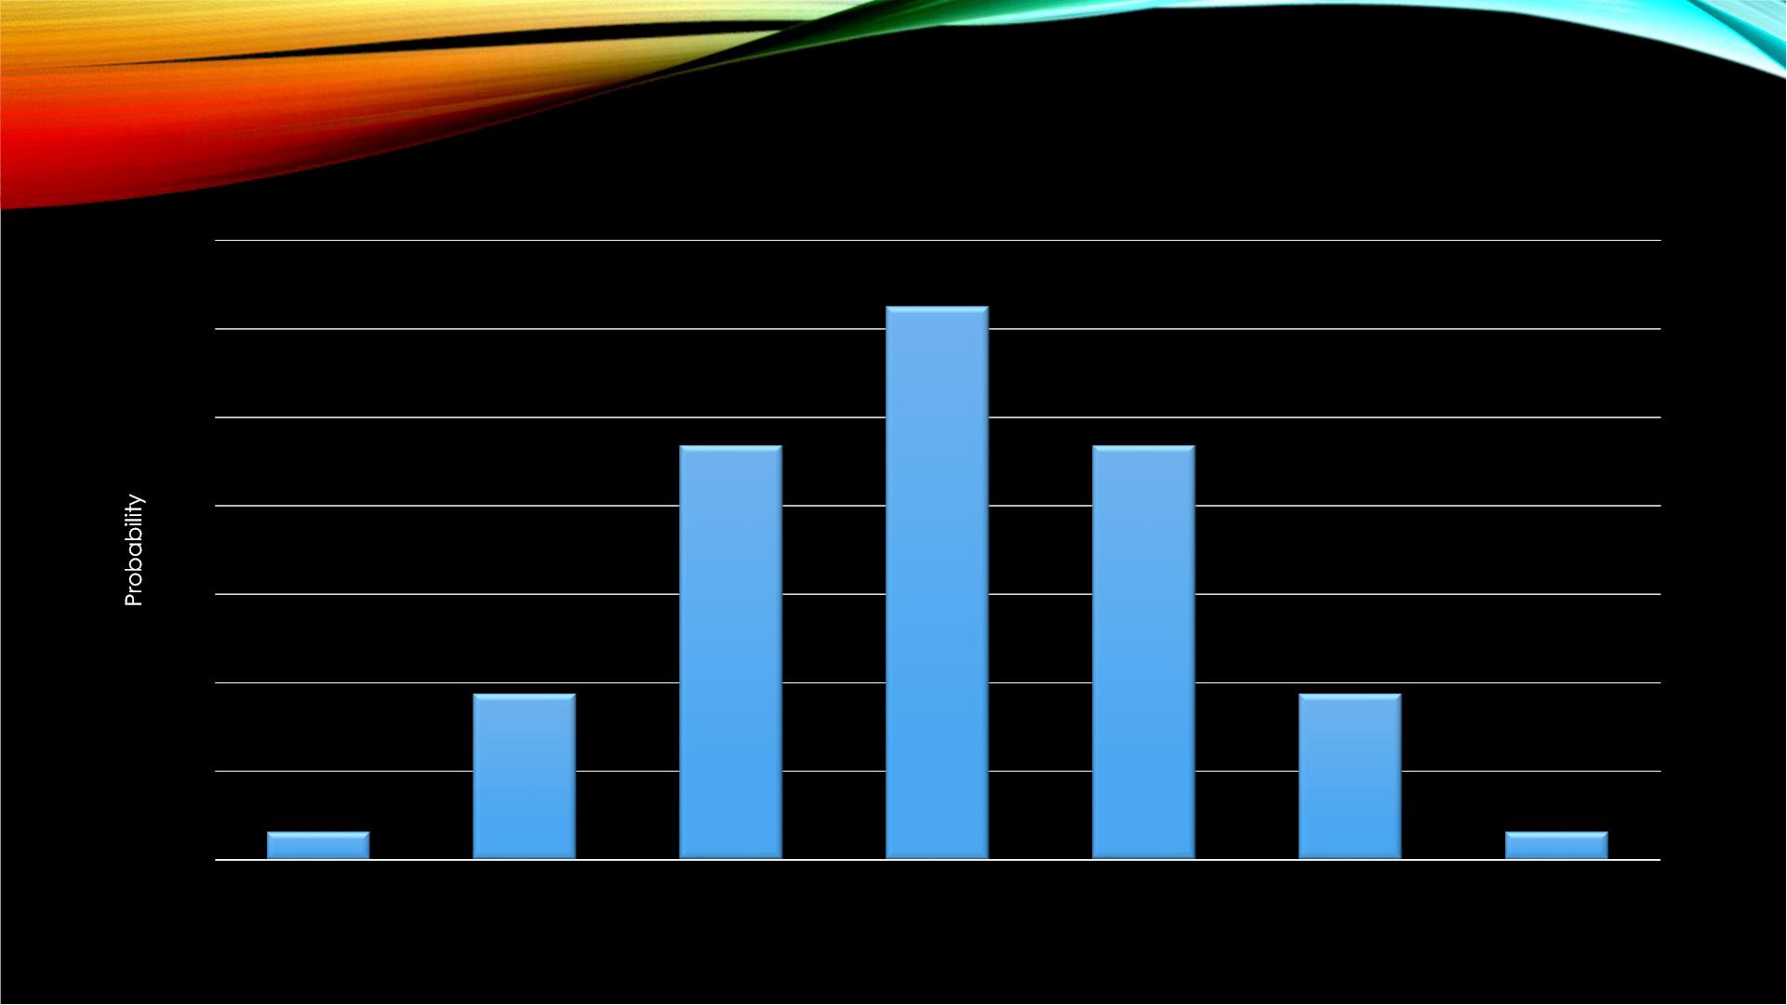
X ~ BIN(6, 0.5)
0.35
0.3
0.25
0.2
0.15
0.1
0.05
0
0
1
2
3
4
5
6
Number of Successes

Slide 47
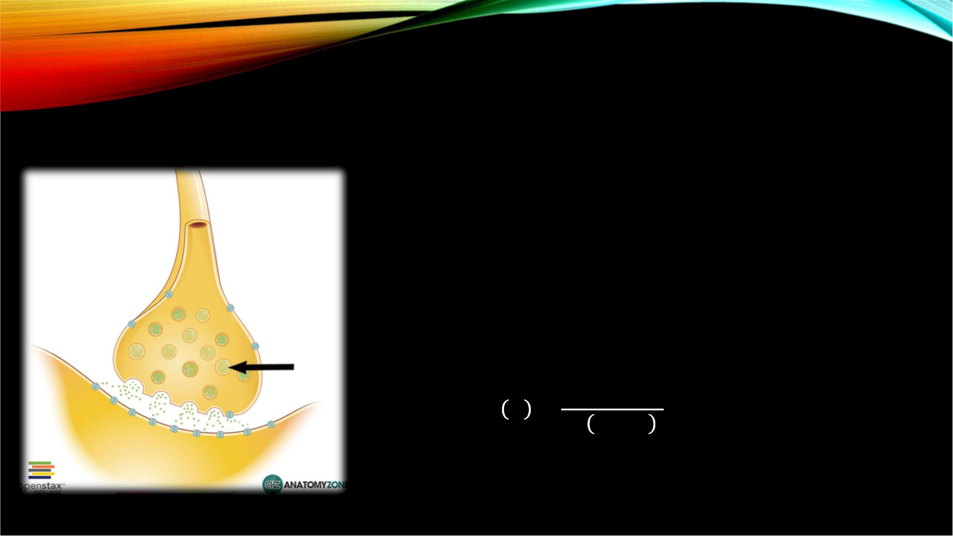



NEUROMUSCULAR JUNCTION:
EXAMPLE
• Consider a nerve terminal containing a number
(n) of synaptic vesicles. Suppose each has a
small chance (p) of fusing with the plasma
membrane and releasing transmitter across the
synapse.
• For the sake of argument let’s suppose that n=3
and p=0.1 (X=number of successes):
푛!
푃 푋 =
푋
푝 (1 $−$ 푝)
푛$−$푋
푋! 푛 $−$푋 !

Slide 48



NEUROMUSCULAR JUNCTION:
EXAMPLE
• 푃 푋 = 0 =
• 푃 푋 = 1 =
• 푃 푋 = 2 =
• 푃 푋 = 3 =
3!
0! 3−0 !
3!
0.1⁰(1 $−$0.1)³⁻⁰
0.1¹(1 $−$0.1)³⁻¹
0.1²(1 $−$0.1)³⁻²
0.1³(1 $−$0.1)³⁻³
1! 3−1 !
3!
2! 3−2 !
3!
3! 3−3 !

Slide 49
THANK YOU!

